Slide 1
Recipe Search Engine
For improvement in Healthy Diet choices

Slide 2
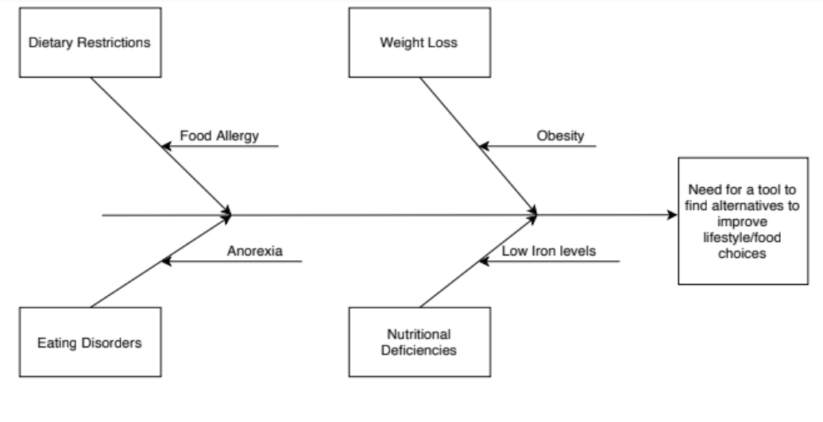
How does the proposed solution solve the problem
Find alternatives to make healthier food choices.
Accounts for Dietary Restrictions.
Displays calories of selected recipe for easy tracking.
Notes:
The diagram helps to clarify by addressing the need for a tool. The recipe search engine helps find alternatives for that provides healthy options for food desired by the user. The selection of ingredients option allows for the user to tailor the recipe based on their nutritional needs. The display of calories gives an opportunity to review whether the recipe fits the user’s daily caloric intake to achieve their desired goals.

Slide 3
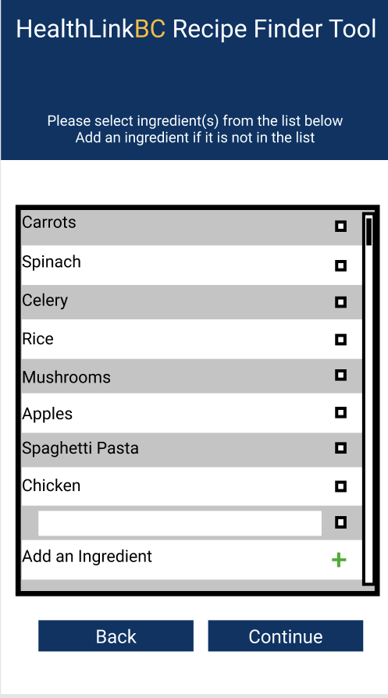
Walkthrough of Prototype
This page is the initial page of the recipe finder feature. This page shows if the recipe finder button is pressed on the general profile page. The user must select ingredients from the list.
Notes:
The user selects ingredients from the list present, if there is an ingredient that the user wants but is not found within the list they can add ingredients to the list by pressing the green plus button and enter the ingredient into the field that pops up.

Slide 4
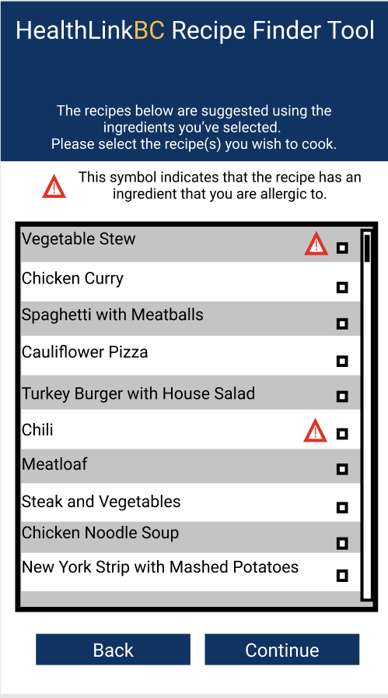
Walkthrough of Prototype (cont.)
This page is where the user can select one or more recipes that they are interested in.
Notes:
The user selects the recipes they wish to further get information on. This page also alerts the user with a caution symbol incase the recipe has any ingredient(s) that the user is allergic too.

Slide 5
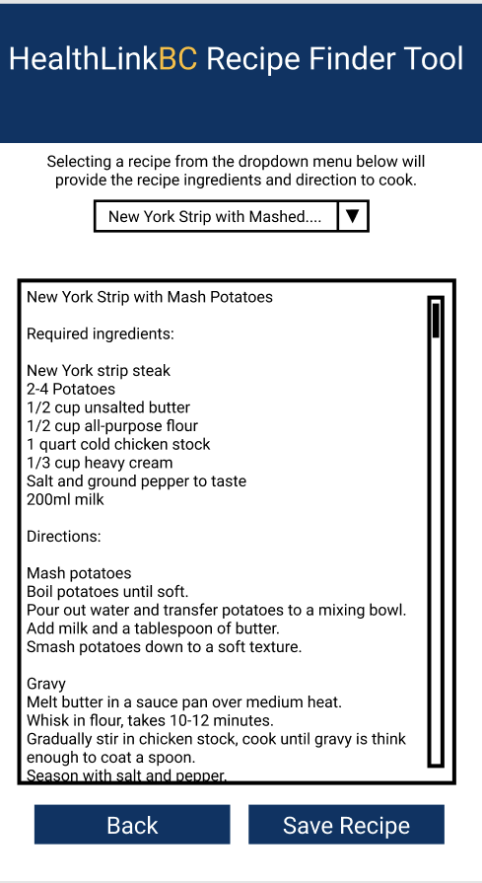
Walkthrough of Prototype (cont.)
This page follows the recipe selection page. This page gives the user the option view the recipes information and save any recipe to their profile.
Notes:
The user uses the drop-down menu to navigate through recipes they previously selected. They are presented with the recipes ingredients and the cooking directions. If the user is interested in the recipe and wants to save the information, they can save it by pressing the “Save Recipe” button.

Slide 6
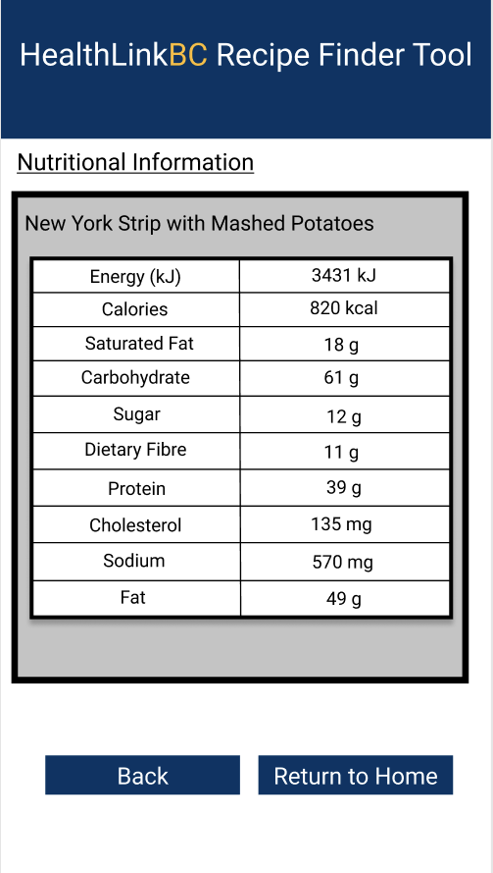
Walkthrough of Prototype (cont.)
This page contains the nutritional information on the saved recipe selected by the user.
Notes:
The user can use this page to find out the nutritional information on each of the recipes they have saved. This information can be used however the user wishes whether it is preparing meals to fit their daily caloric goals or just wanting to simply know the information.

Slide 7
Possible Risks and Mitigation Strategies
Shortfall in externally performed tasks and user performance:
The search engine in the application fails to provide accurate information to users which leads to user dissatisfaction or cause health related problems for the users. This risk can be mitigated if the product goes through proper testing and user feedback loop.
Developing the wrong user interface for the target audience:
The user interface of the search engine is ambiguous and not simplistic enough for such a broad range of audience to use. This is the case when the objective of the tool is to promote healthy eating for population in BC. The risk can be mitigated if proper testing is done with broad range of user groups that meet the target audience in BC.
Data and Security problems for users:
Users’ personal Information and data is not protected from both external and internal factors will cause several issues for the product. Users will lose trust in the product and the organization might even face legal consequences. This risk can be mitigated if an experienced team with proper technical expertise is working on the project.
Notes:
The project faces 3 potential risks that needs to be mitigated. These risks are (The main bullet points).
The mitigation strategy for Shortfall in externally performed tasks and user performance: is to make sure the product goes through proper testing and user feedback loop.
The mitigation strategy for Developing the wrong user interface for the target audience: is to make sure the correct user group is selected for testing that meet the target audience in BC.
The mitigation strategy for Data and Security problems for users: is to have an experienced team with proper technical expertise working on the project.

Slide 8
Funding Decisions
Implementation time:
We’ve been given a one year time frame to complete our goals and deliver a working product.
Notes:
HealthLink BC has generously provided us with a budget of $100,000 CAD that is distributed as follows. We expect to have a working product within a year of starting the project.

Slide 9
Benefits over other solutions
Personalized Content
Recipes and other content will be centered around user preferences. User-centric personalization is critical in making their experience a positive one.
Instant Online and Offline Access
Offers instant one-tap access. This allows for seamless uninterrupted access by the end-user.
Push Notifications and Instant Updates
Helps users stay updated constantly and allows them to view new suggested recipes.
Interactive Engagement
Increases user engagement due to how a mobile interface offers a more immersive experience. This results in an increase in end-user commitment in making healthy dietary choices.
Notes:
Our product offers numerous benefits. Some of them include (mention the 4 benefits listed in the table).
Then read out the details for each benefit.

