Slide 1
Recipe Search Engine
For improvement in Healthy Diet choices

Slide 2
How does the proposed solution solve the problem
Help find alternatives to make healthier food choices.
Find healthier recipes through search engine
Allows for selection of ingredients.
Accounts for dietary restrictions
Displays calories of selected recipe.
Track calories in/out
Notes:
The diagram helps to clarify by addressing the need for a tool. The recipe search engine helps find alternatives for that provides healthy options for food desired by the user. The selection of ingredients option allows for the user to tailor the recipe based on their nutritional needs. The display of calories gives an opportunity to review whether the recipe fits the user’s daily caloric intake to achieve their desired goals.

Slide 3
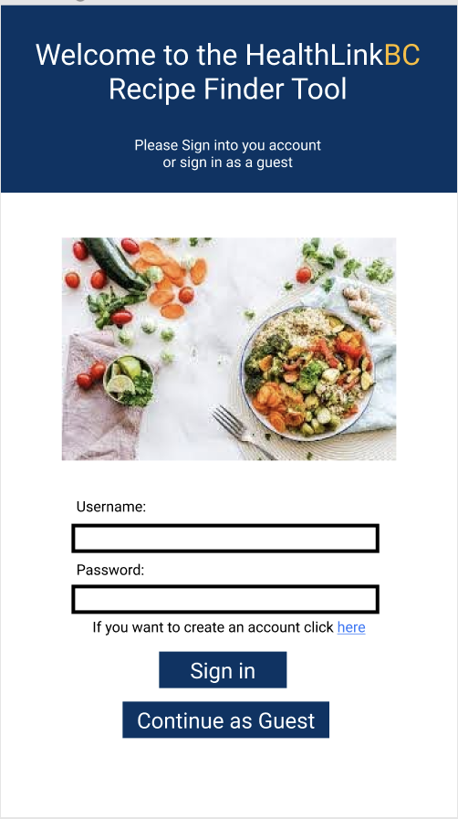
Walkthrough of Prototype
This is the homepage of the HealthlinkBC Recipe Finder Tool. The user must sign into an existing account, create a new account or continue as a guest.
Notes:
This is the first page the user is presented when opening the HealthlinkBC Recipe Finder Tool. They are presented three options, sign into an existing account, create an account or continue as a guest.

Slide 4
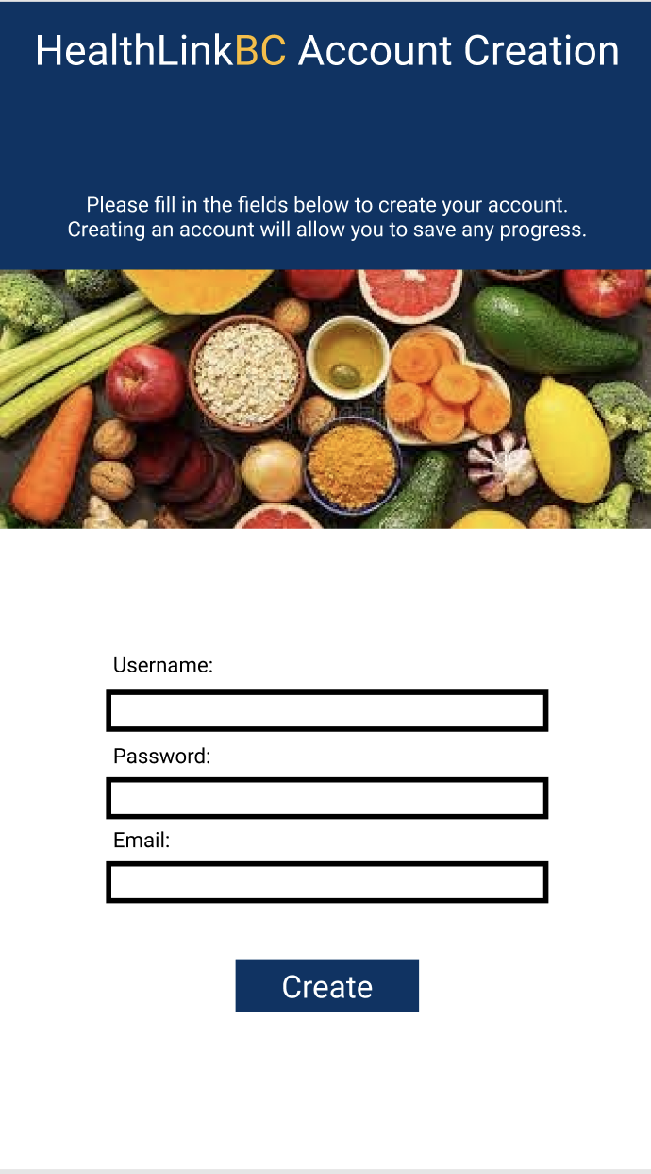
Walkthrough of Prototype (cont.)
This is the user account creation page where the user enters in information into the fields available.
Notes:
This page only requires the username, password and email to create the account. The user will also have to fill in more information into the profile page which will contain more detailed information about the user. This information will help with the recipe finder tool.

Slide 5
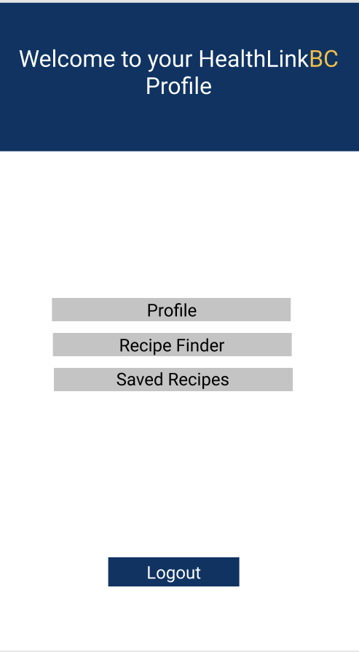
Walkthrough of Prototype (cont.)
This is the general profile page which contains all the features available in the recipe finder tool.
Notes:
This page allows the user to navigate through the available features.

Slide 6
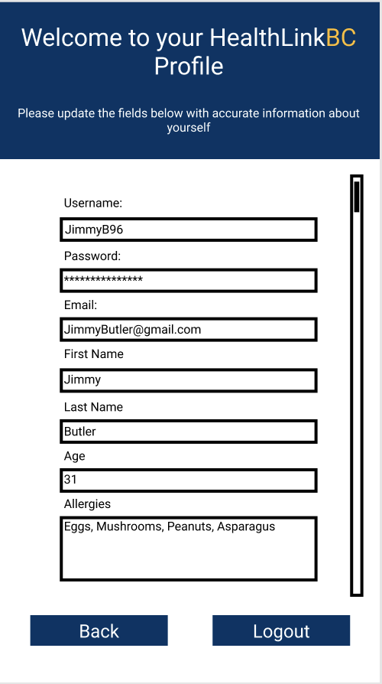
Walkthrough of Prototype (cont.)
This is the profile page where the user fills in information which will help with the recipe finder feature.
Notes:
The user fills in the fields in the profile page so the recipe finder feature can use the information to help notify the user in cases such as allergies.

Slide 7
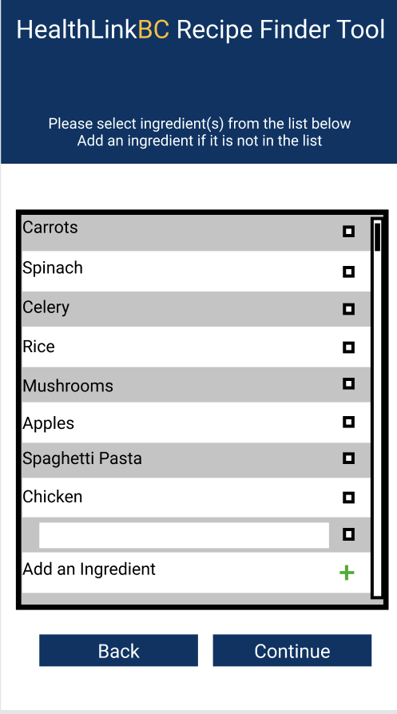
Walkthrough of Prototype (cont.)
This page is the initial page of the recipe finder feature. This page shows if the recipe finder button is pressed on the general profile page. The user must select ingredients from the list.
Notes:
The user selects ingredients from the list present, if there is an ingredient that the user wants but is not found within the list they can add ingredients to the list by pressing the green plus button and enter the ingredient into the field that pops up.

Slide 8
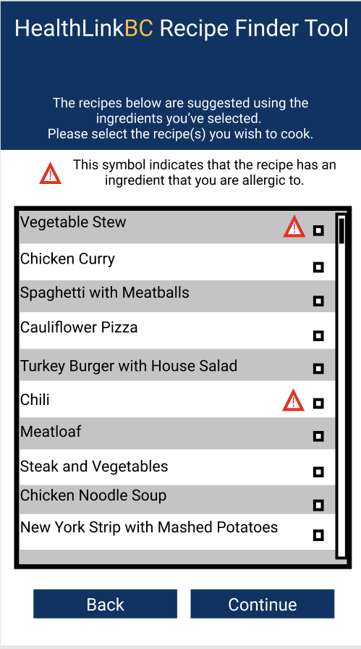
Walkthrough of Prototype (cont.)
This page is where the user can select one or more recipes that they are interested in.
Notes:
The user selects the recipes they wish to further get information on. This page also alerts the user with a caution symbol incase the recipe has any ingredient(s) that the user is allergic too.

Slide 9
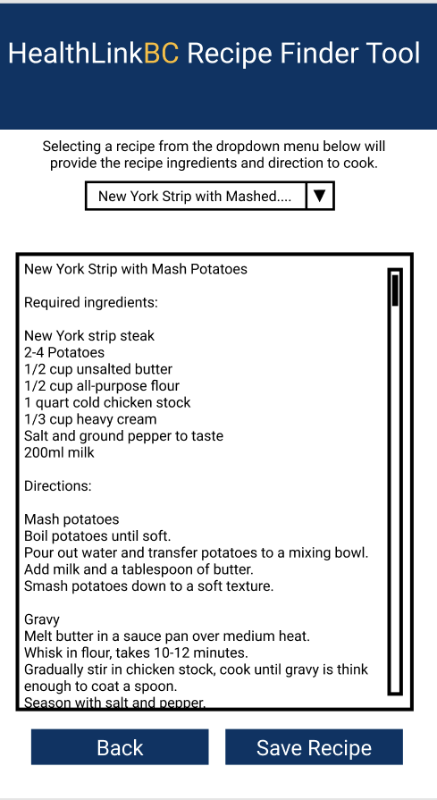
Walkthrough of Prototype (cont.)
This page follows the recipe selection page. This page gives the user the option view the recipes information and save any recipe to their profile.
Notes:
The user uses the drop-down menu to navigate through recipes they previously selected. They are presented with the recipes ingredients and the cooking directions. If the user is interested in the recipe and wants to save the information, they can save it by pressing the “Save Recipe” button.

Slide 10
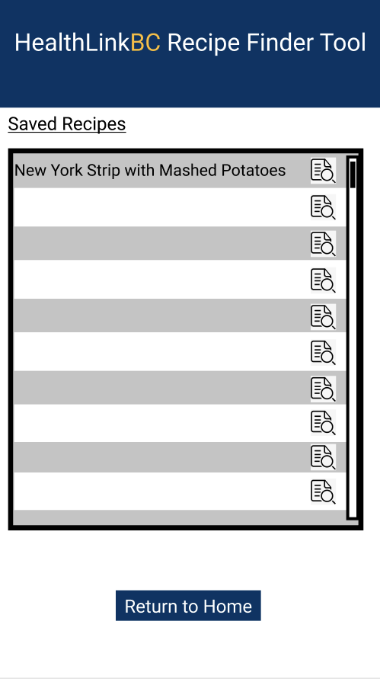
Walkthrough of Prototype (cont.)
This page contains the saved recipe feature which contains all the recipes that the user has saved using the recipe finder feature.
Notes:
The user can sift through any of the saved recipes they found using the recipe finder feature. They can also press the button on the right to get the nutritional information of the recipe. Guests accounts will be able to save recipes however, all the data they have saved is not going to be saved into the HealthlinkBC recipe finder tool’s database. Once the guest account logs out all their searches and saved recipes are then deleted and the user will have to go through the entire process again if they wish to find the same recipes.

Slide 11
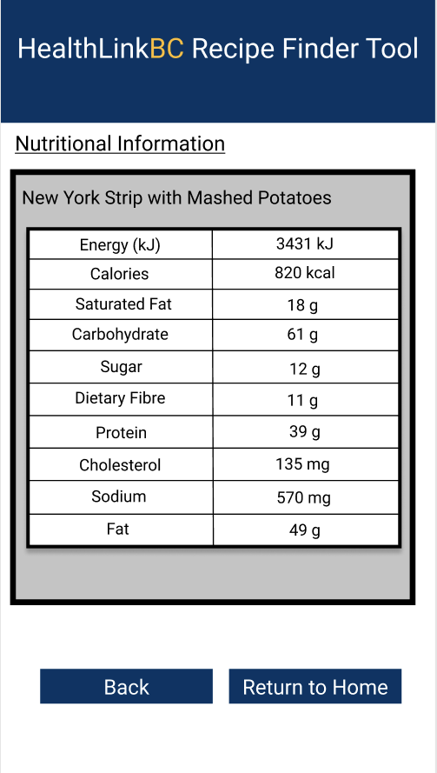
Walkthrough of Prototype (cont.)
This page contains the nutritional information on the saved recipe selected by the user.
Notes:
The user can use this page to find out the nutritional information on each of the recipes they have saved. This information can be used however the user wishes whether it is preparing meals to fit their daily caloric goals or just wanting to simply know the information.

Slide 12
Possible Risks/Mitigation Strategies
Shortfall in externally performed tasks and user performance:
The search engine in the application fails to provide accurate information to users which leads to user dissatisfaction or cause health related problems for the users. This risk can be mitigated if the product goes through proper testing and user feedback loop.
Developing the wrong user interface for the target audience:
The user interface of the search engine is ambiguous and not simplistic enough for such a broad range of audience to use. This is the case when the objective of the tool is to promote healthy eating for population in BC. The risk can be mitigated if proper testing is done with broad range of user groups that meet the target audience in BC.
Data and Security problems for users:
Users’ personal Information and data is not protected from both external and internal factors will cause several issues for the product. Users will lose trust in the product and the organization might even face legal consequences. This risk can be mitigated if an experienced team with proper technical expertise is working on the project.
Notes:
The project faces 3 potential risks that needs to be mitigated. These risks are (The main bullet points).
The mitigation strategy for Shortfall in externally performed tasks and user performance: is to make sure the product goes through proper testing and user feedback loop.
The mitigation strategy for Developing the wrong user interface for the target audience: is to make sure the correct user group is selected for testing that meet the target audience in BC.
The mitigation strategy for Data and Security problems for users: is to have an experienced team with proper technical expertise working on the project.

Slide 13
Expected costs and implementation time
Costs:
Initial Prototype: $20,000
System Development: $40,000
UX/UI Design: $20,000
Maintenance Costs: $20,000
Implementation time:
We’ve been given a one year time frame to complete our goals and deliver a working product.
Notes:
HealthLink BC has generously provided us with a budget of $100,000 CAD that is distributed as follows. We expect to have a working product within a year of starting the project.

Slide 14
Benefits over other solutions
Benefit | Detail
Personalized Content | Recipes and other content will be centered around users preferences. User-centric personalization is critical in making their experience delightful.
Instant Online and Offline access | Offers instant tap access. Making it seamless experience for users.
Push Notifications and Instant Updates | Helps users stay updated constantly and allows them to view new recipes which benefits them.
Interactive Engagement | Increases engagement due to mobile interface offers more immersive experience and help users stay committed to healthy eating.
Notes:
Our product offers numerous benefits. Some of them include (mention the 4 benefits listed in the table).
Then read out the details for each benefit.

